Slide 1
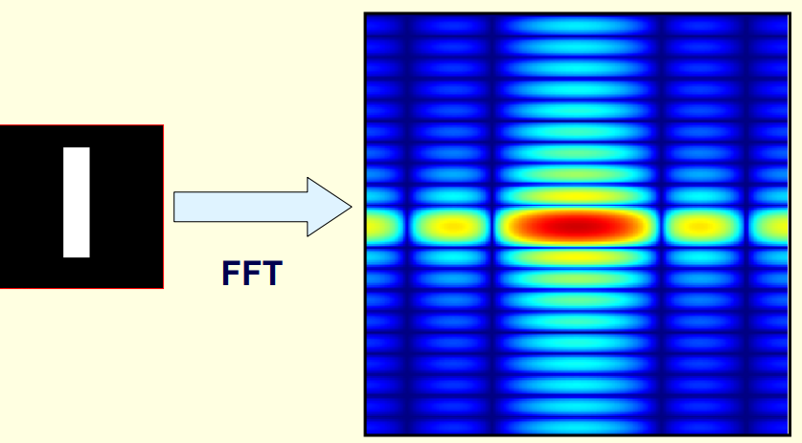
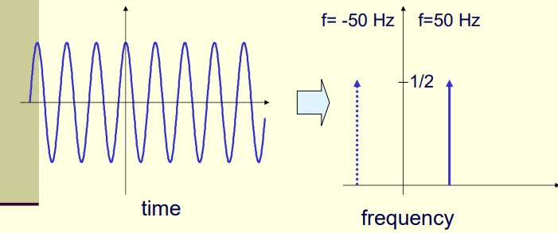
Fourier transformation
The Fourier Transform is used to decompose an image into its sine and cosine components.
The output of the transformation represents the image in frequency domain, while the input image is the spatial domain equivalent.
In the Fourier (Frequency) domain image, each point represents a particular frequency contained in the spatial domain image.
Common Names: Fourier Transform, Spectral Analysis, Frequency Analysis

Slide 2
Why do we convert images to spectrum domain?
For exposing image features not visible in spatial domain.
For achieving more compact image representation (coding), eg. JPEG, JPEG2000
For designing digital filters.
For fast processing of images, eg. digital filtering of images in spectrum domain

Slide 3
Applications / use of FT
The Fourier Transform is used in a wide range of image processing activities such as
Image analysis
Image filtering
Image reconstruction
Image compression.

Slide 4
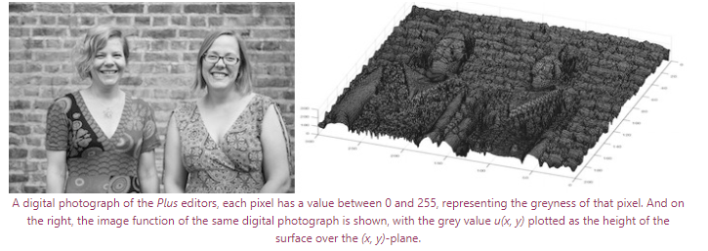
IMAGES as a varying function of pixel intensity variation
Assume an image as a varying function - however, rather than varying in time it varies across the two-dimensional space of the image.
In a grey scale digital image the pixels each have a value between 0 and 255 representing the darkness of that pixel.
So the darkness, or intensity, of that pixel, is a function of the horizontal and vertical coordinates giving the location of that pixel.
You can think of the image as a landscape, with the height of the landscape given by the value / intensity of the pixel.
Image Src: https://plus.maths.org/content/fourier-transforms-images

Slide 5
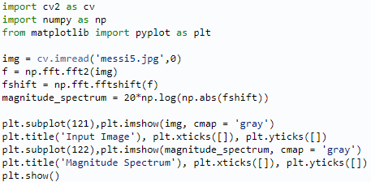
FT USING NUMPY & OPENCV
For images, 2D Discrete Fourier Transform (DFT) is used to find the frequency domain. A fast algorithm called Fast Fourier Transform (FFT) is used for calculation of DFT.
Fourier Transform using Numpy:
Numpy has an FFT package to do this. np.fft.fft2() provides us the frequency transform which will be a complex array.
Its first argument is the input image, which is grayscale.
Second argument is optional which decides the size of output array.
After this result, zero frequency component (DC component) will be at top left corner.
If you want to bring it to center, you need to shift the result by using the function - np.fft.fftshift().
Once you found the frequency transform, you can find the magnitude spectrum.
Other related functions:
np.fft.ifftshift() - DC component again come at the top-left corner.
np.ifft2() - inverse FFT

Slide 6
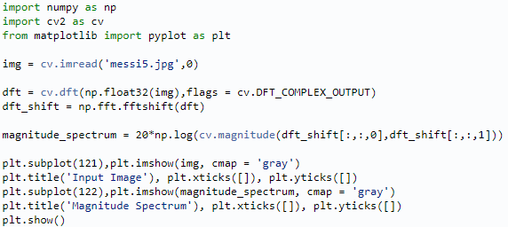
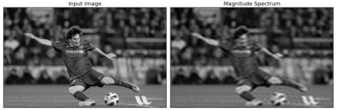
FT USING NUMPY & OPENCV
Fourier Transform in OpenCV:
OpenCV provides the functions cv.dft() and cv.idft() for this.
It returns the result with two channels.
First channel will have the real part of the result and second channel will have the imaginary part of the result.
The input image should be converted to np.float32 first.

Slide 7
References
https://docs.opencv.org/3.4/de/dbc/tutorial_py_fourier_transform.html
https://docs.opencv.org/3.4/d8/d01/tutorial_discrete_fourier_transform.html

